Slide 1
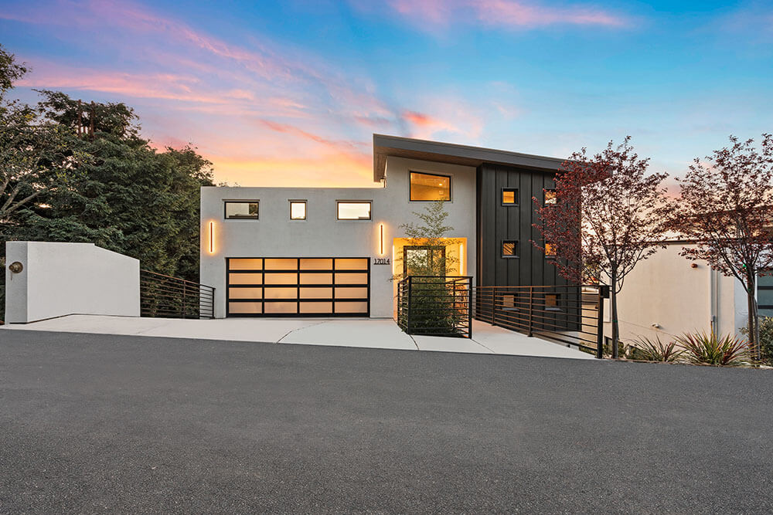

BROKERAGE MEETING
Your brokerage,
distinctively empowered.
[MEETING PURPOSE]
[MONTH 00, 2026] • [LOCATION]
AERIAL CANVAS × [BROKERAGE]
Notes:
LAYOUT: Full-bleed title
USE: Lead with one strong property or BTS image. Keep the title to two lines and the meeting purpose to one line.
BRAND: Poppins-led typography; full logo preferred when space allows; official palette and current-site periwinkle accent. Replace sample text and photography before external use.

Slide 2
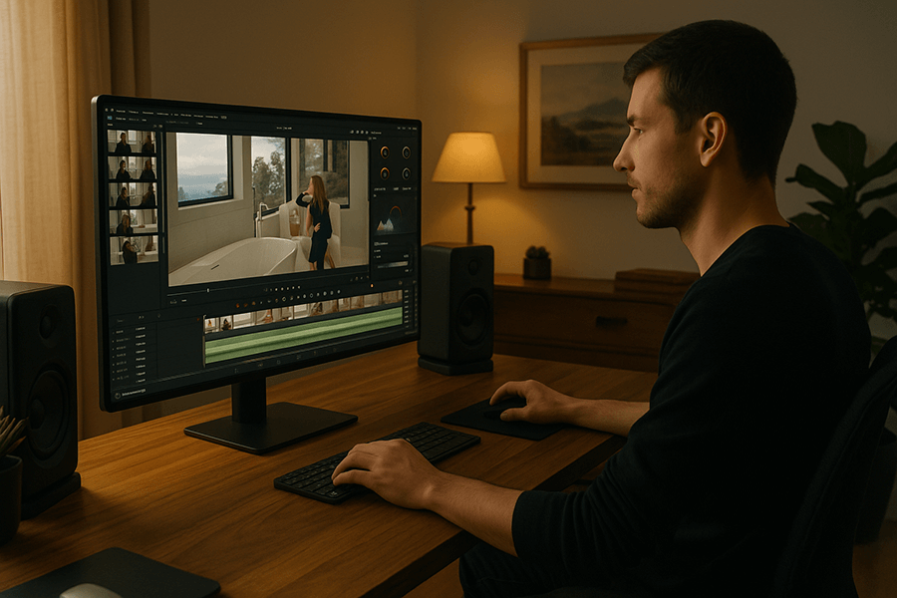
ALTERNATE COVER
Create the edge
your agents can feel.
[EXECUTIVE MEETING PURPOSE OR SUBTITLE]
Notes:
LAYOUT: Minimal title
USE: Best for executive briefings or a darker room. Replace the right-side image with a vertical BTS frame.
BRAND: Poppins-led typography; full logo preferred when space allows; official palette and current-site periwinkle accent. Replace sample text and photography before external use.

Slide 3

MEETING MAP
A clear path from vision to execution
01
What we heard
Brokerage priorities and current experience
02
The opportunity
Where media can create a sharper market edge
03
How we deliver
People, process, quality and support
04
Recommended next step
Pilot, rollout and ownership
[MEETING OUTCOME]
Notes:
LAYOUT: Agenda / roadmap
USE: Keep to four major beats. Use the right-side descriptions as speaking outcomes, not topic repetition.
BRAND: Poppins-led typography; full logo preferred when space allows; official palette and current-site periwinkle accent. Replace sample text and photography before external use.

Slide 4
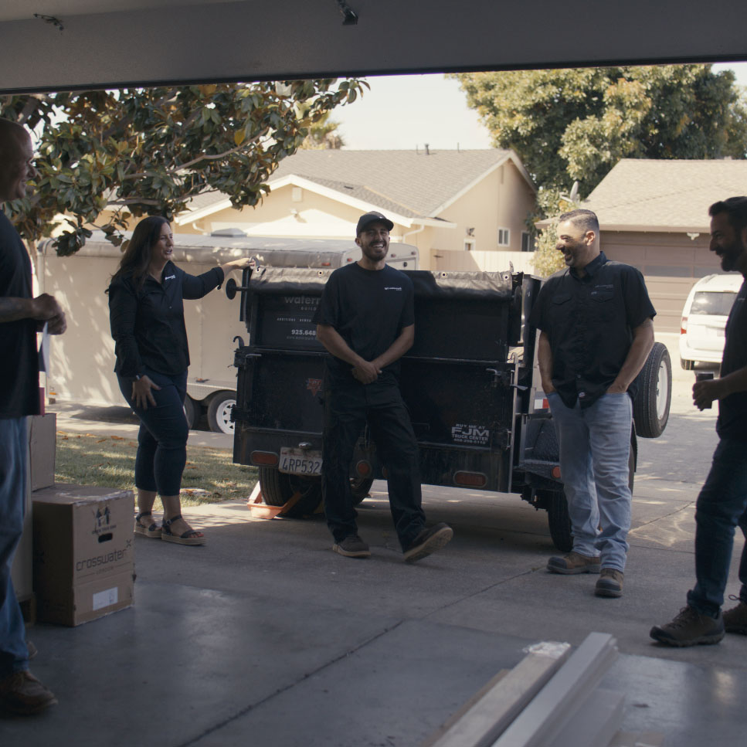
SECTION 01
Start with
what matters most.
[ONE-SENTENCE SECTION FRAME]
Notes:
LAYOUT: Section divider
USE: Use a BTS image that visually supports the next section. One headline, one framing sentence, no bullets.
BRAND: Poppins-led typography; full logo preferred when space allows; official palette and current-site periwinkle accent. Replace sample text and photography before external use.

Slide 5
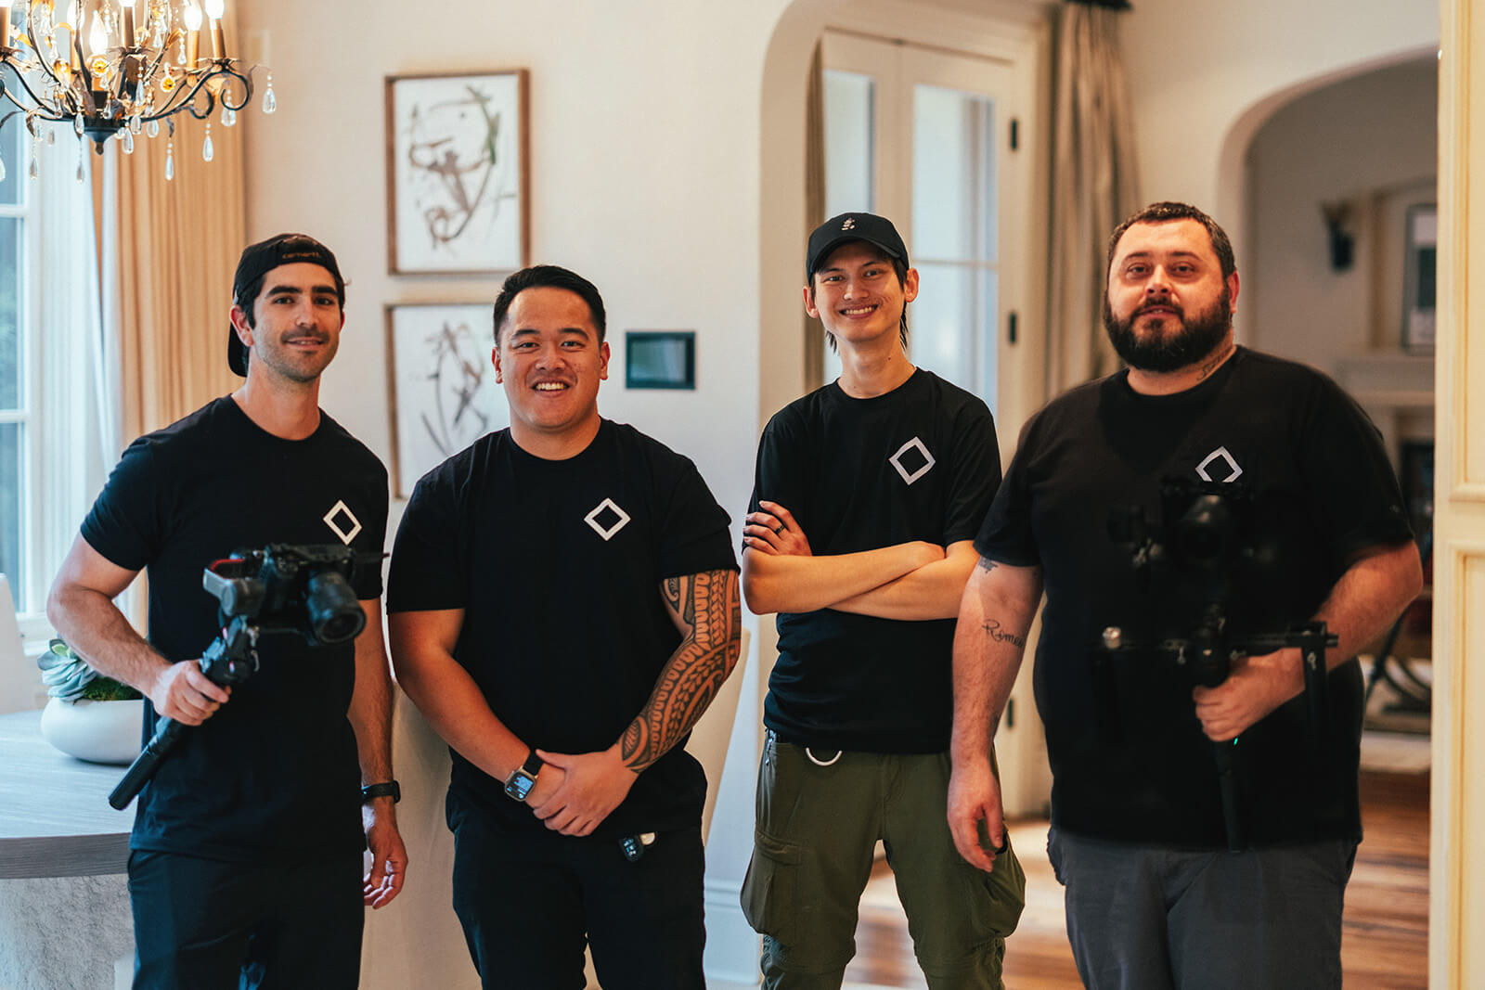
POINT OF VIEW
Media should build the agent,
not just market the listing
[STRATEGIC ARGUMENT OR “ABOUT US” STORY]
Make every touchpoint feel intentional
Give agents a repeatable way to stand out
Make quality easier to access and deliver
YOUR TEAM,
ON SPEED DIAL
Notes:
LAYOUT: Narrative + team image
USE: Use for the central idea or company story. Keep the left side to one paragraph and three concise principles.
BRAND: Poppins-led typography; full logo preferred when space allows; official palette and current-site periwinkle accent. Replace sample text and photography before external use.

Slide 6
OPPORTUNITY
The best brokerage experience
should also be the easiest one.
[INSERT ONE APPROVED PROOF POINT]
Notes:
LAYOUT: Big statement
USE: A pause slide. Use one memorable sentence plus one supporting line; do not add a list.
BRAND: Poppins-led typography; full logo preferred when space allows; official palette and current-site periwinkle accent. Replace sample text and photography before external use.

Slide 7
PROOF AT A GLANCE
Turn outcomes into a simple visual rhythm
1,000+
[METRIC]
[METRIC]
agents and companies
[OUTCOME LABEL]
[OUTCOME LABEL]
Verified website claim
[SOURCE / PERIOD]
[SOURCE / PERIOD]
Historical results • Current activity • Future potential
Notes:
LAYOUT: Metrics / proof
USE: Use three metrics maximum. Cite the source in notes or a small footer. Never mix actual and projected outcomes.
BRAND: Poppins-led typography; full logo preferred when space allows; official palette and current-site periwinkle accent. Replace sample text and photography before external use.

Slide 8
CAPABILITIES
One partner. A complete media ecosystem.
PHOTOGRAPHY
VIDEO
DRONE
Bright, natural and composition-led
Cinematic stories built to connect
Perspective that expands the story
3D + FLOOR PLANS
SOCIAL
BRAND + PRODUCTION
Clarity for buyers before the visit
Platform-ready content with an edge
Campaigns, profiles and commercial work
Notes:
LAYOUT: Capability grid
USE: Use for six services or offer pillars. Keep descriptions to one line and group related capabilities in the same row.
BRAND: Poppins-led typography; full logo preferred when space allows; official palette and current-site periwinkle accent. Replace sample text and photography before external use.

Slide 9
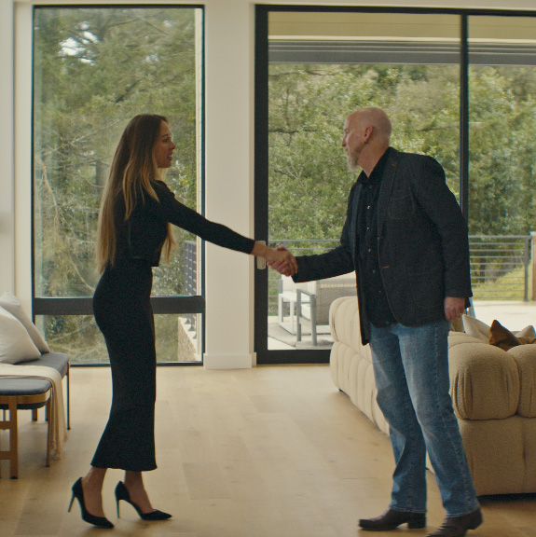
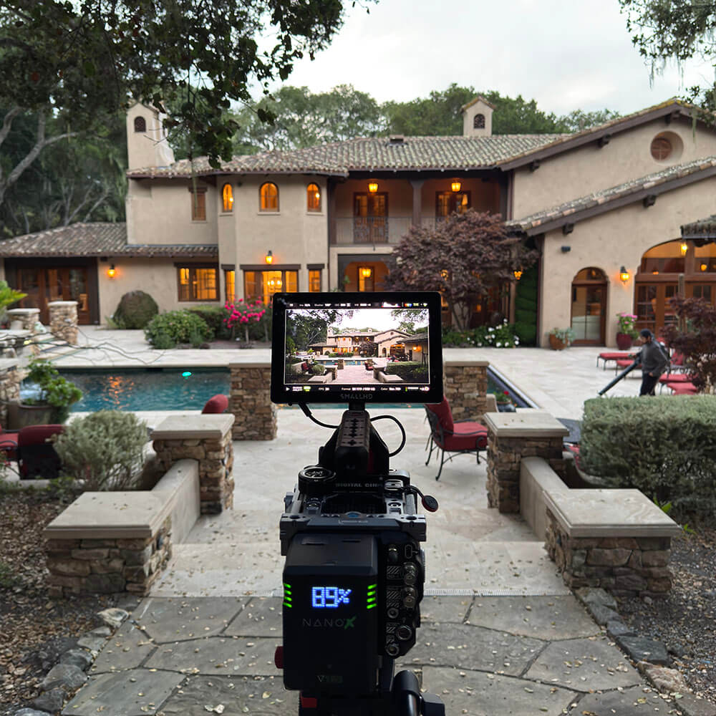
THE AERIAL CANVAS PROCESS
A human-first workflow from idea to delivery
01
Consultation
02
Pre-production
03
Production day
04
Post-production
Consult → Plan → Capture → Deliver
Notes:
LAYOUT: Four-stage process
USE: Keep the visible stage names short. Replace all four images together so the visual sequence feels intentional.
BRAND: Poppins-led typography; full logo preferred when space allows; official palette and current-site periwinkle accent. Replace sample text and photography before external use.

Slide 10
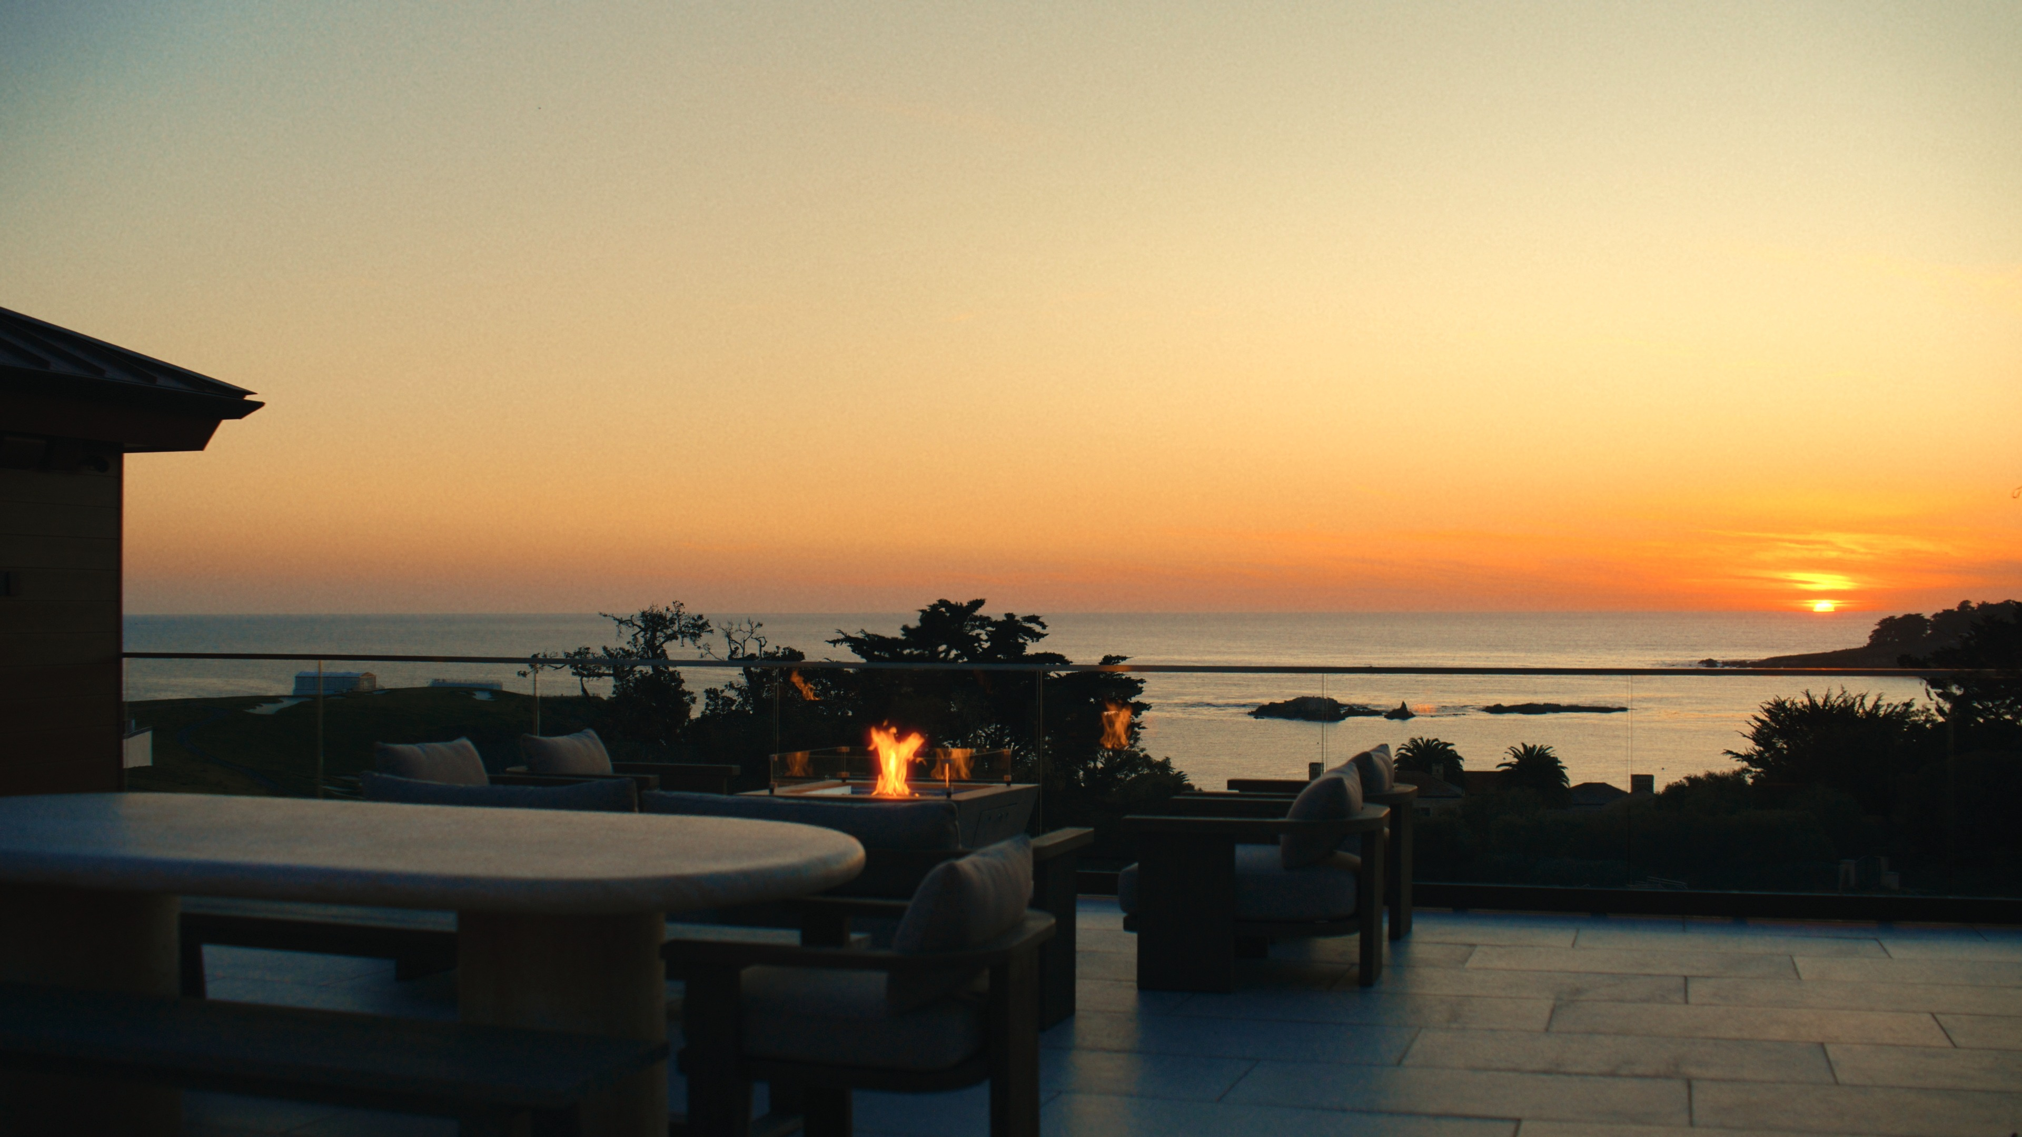
CASE STUDY
[PROJECT / BROKERAGE]
CHALLENGE
[Describe the specific business or marketing challenge in one or two sentences.]
APPROACH
[Name the service mix and the choices that made the work distinctive.]
[APPROVED RESULT / OUTCOME]
[SOURCE / PROJECT REFERENCE]
Notes:
LAYOUT: Image-led case study
USE: Use one hero frame and a challenge / approach / result narrative. Only use approved outcomes and identify projected values as potential.
BRAND: Poppins-led typography; full logo preferred when space allows; official palette and current-site periwinkle accent. Replace sample text and photography before external use.

Slide 11
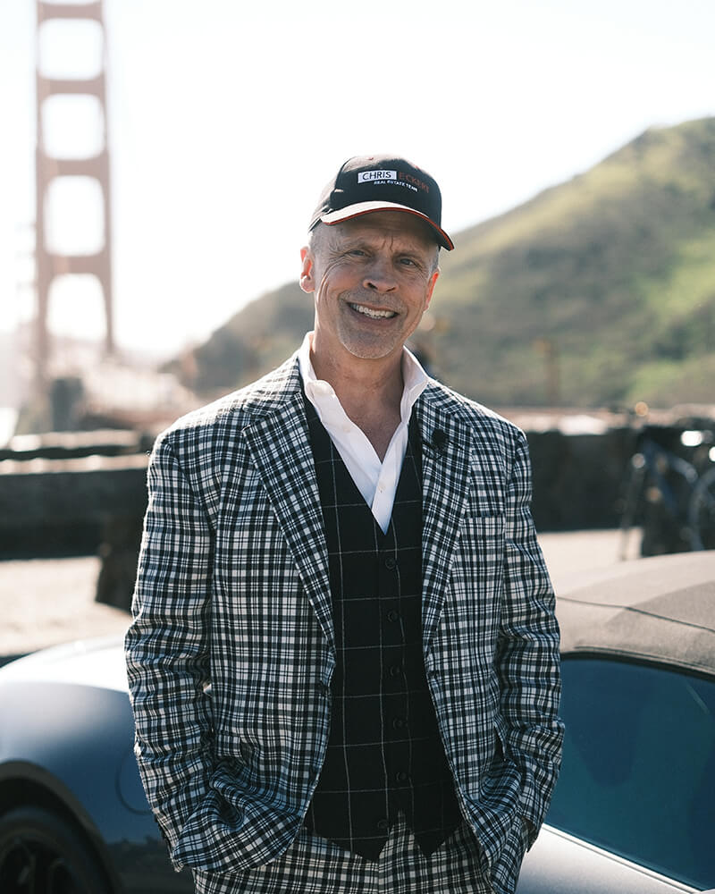
CLIENT PERSPECTIVE
“
[INSERT ONE CONCISE, APPROVED CLIENT QUOTE]
[CLIENT NAME] • [BROKERAGE]
CLIENT PROOF
Notes:
LAYOUT: Testimonial / proof
USE: Use a verified quote and approved attribution. Replace the sample team image with a customer or project image when permission exists.
BRAND: Poppins-led typography; full logo preferred when space allows; official palette and current-site periwinkle accent. Replace sample text and photography before external use.

Slide 12
×
[BROKERAGE LOGO]
CO-BRANDED SECTION
A partnership designed around your agents
[PARTNERSHIP MESSAGE: explain how the combined brands will serve the brokerage and its agents.]
[BROKERAGE
BRAND AREA]
AERIAL CANVAS SYSTEM
+ BROKERAGE ACCENT
Notes:
LAYOUT: Co-branding
USE: Add the brokerage logo at top left and use one approved accent color. Do not recolor, distort or separate the Aerial Canvas wordmark and icon.
BRAND: Poppins-led typography; full logo preferred when space allows; official palette and current-site periwinkle accent. Replace sample text and photography before external use.

Slide 13
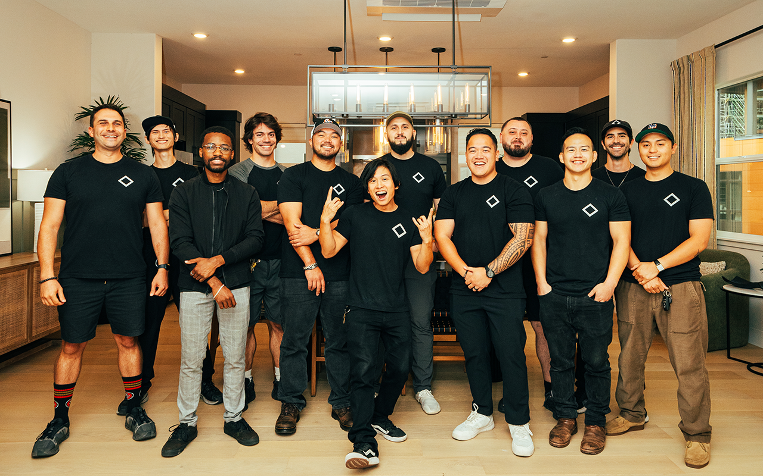
THE PEOPLE BEHIND THE WORK
A dedicated team that makes execution feel easy
PROJECT MANAGEMENT
One accountable point of contact
CREATIVE SPECIALISTS
Photography, video and drone expertise
POST-PRODUCTION
Consistent quality and polished delivery
[OPTIONAL TEAM / MARKET NOTE]
Notes:
LAYOUT: Team + roles
USE: Use one real team image and three role groups. Avoid dense org charts in a brokerage meeting.
BRAND: Poppins-led typography; full logo preferred when space allows; official palette and current-site periwinkle accent. Replace sample text and photography before external use.

Slide 14
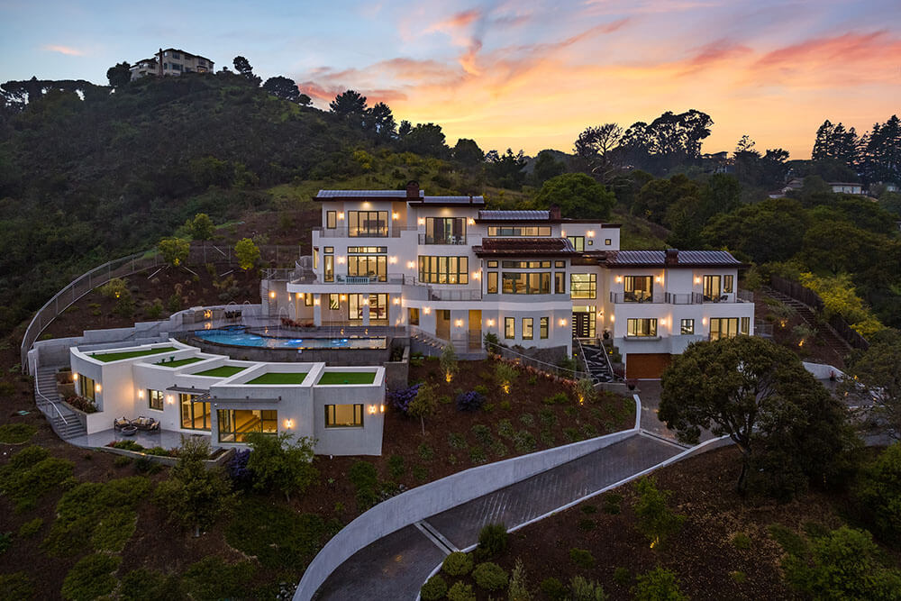
NEXT STEP
Ready to define
your edge?
[AGREED NEXT ACTION / PILOT SCOPE / Q&A]
[OWNER] • [ACTION] • [DATE]
aerialcanvas.com
Notes:
LAYOUT: Closing / Q&A
USE: End with one next action and an owner. If this is Q&A, remove the owner/action/date pill and keep the slide visually quiet.
BRAND: Poppins-led typography; full logo preferred when space allows; official palette and current-site periwinkle accent. Replace sample text and photography before external use.

